Slide 1


ARE YOU READY?
IN THE STADIUM
Witness your team battle it out from February 2-4!

Slide 2
The Idea:
In the stadium is a web site that help you to reserve a stadium to you and your friends with your date that you choose.

Slide 3
introduction:
Football is the most well-known sport around the whole world and most people Watch, play and encourages it and most of us if not all are playing it daily in Everywhere you can imagine, in the streets, colleges, clubs, beach and etc.
so we create this web site for you

Slide 4
used tecnology:
html
css
figma
photoshop
github

Slide 5

screen shots:
home page

Slide 6
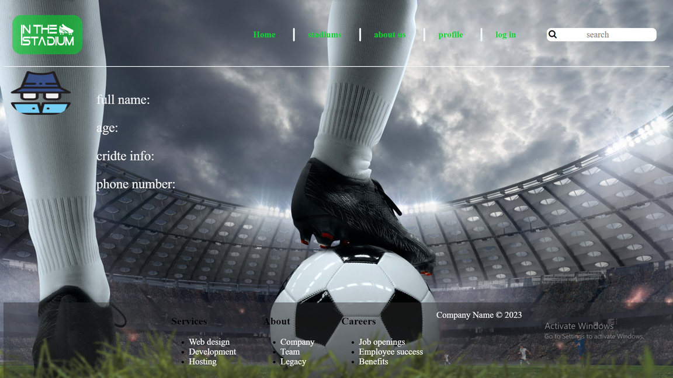
screen shots:
profile

Slide 7
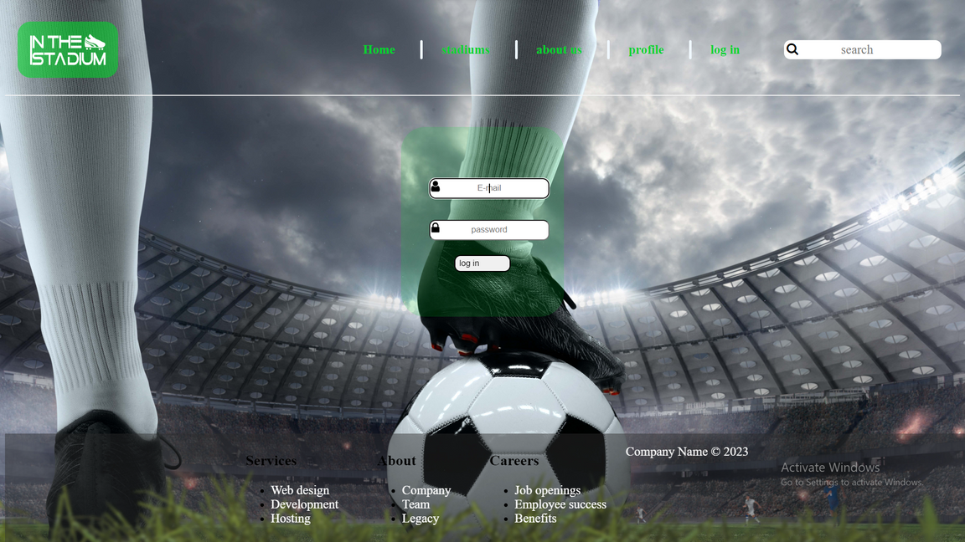
screen shots:
log in

Slide 8
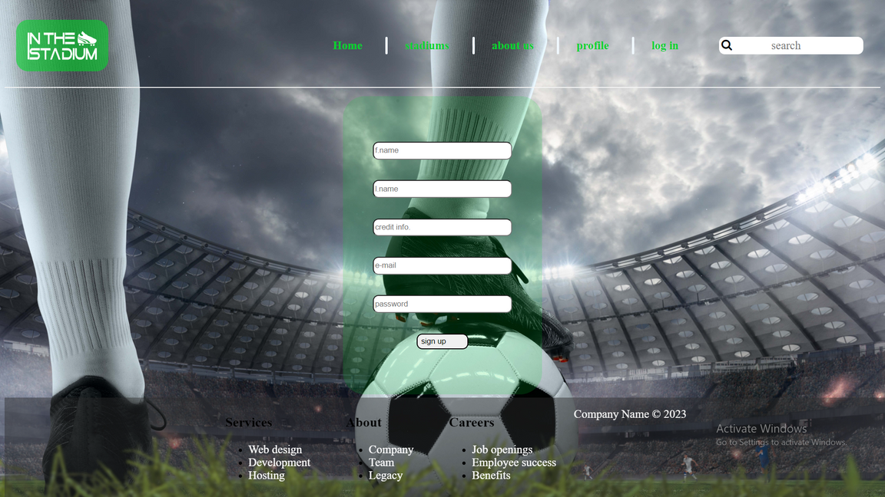
screen shots:
sign up

Slide 9
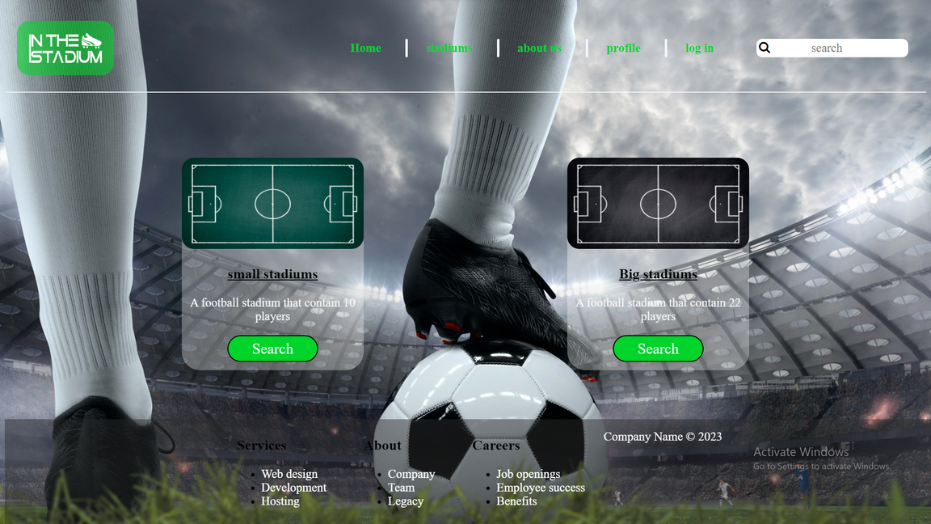
screen shots:
stadiums

Slide 10
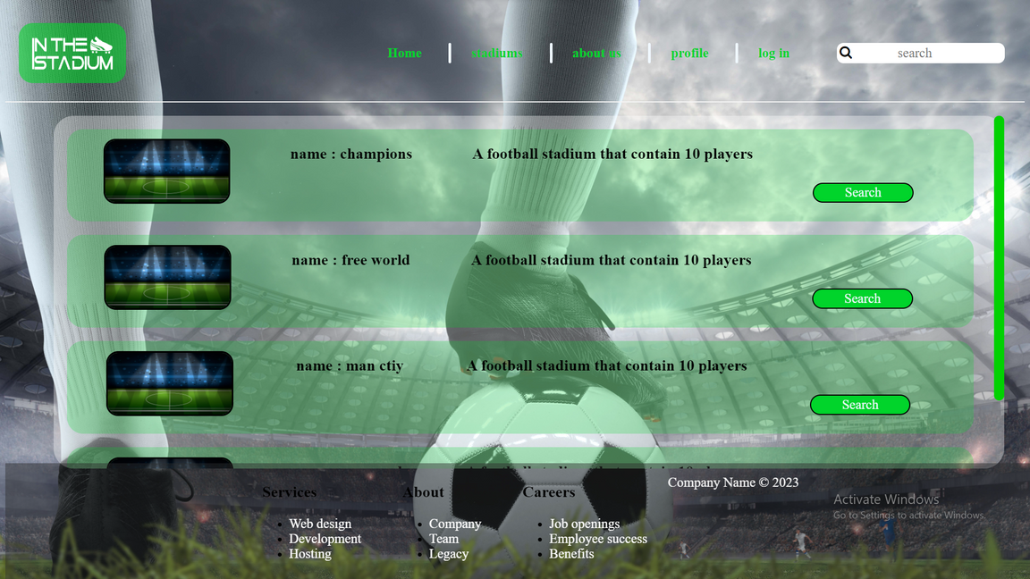
screen shots:
small staduim

Slide 11
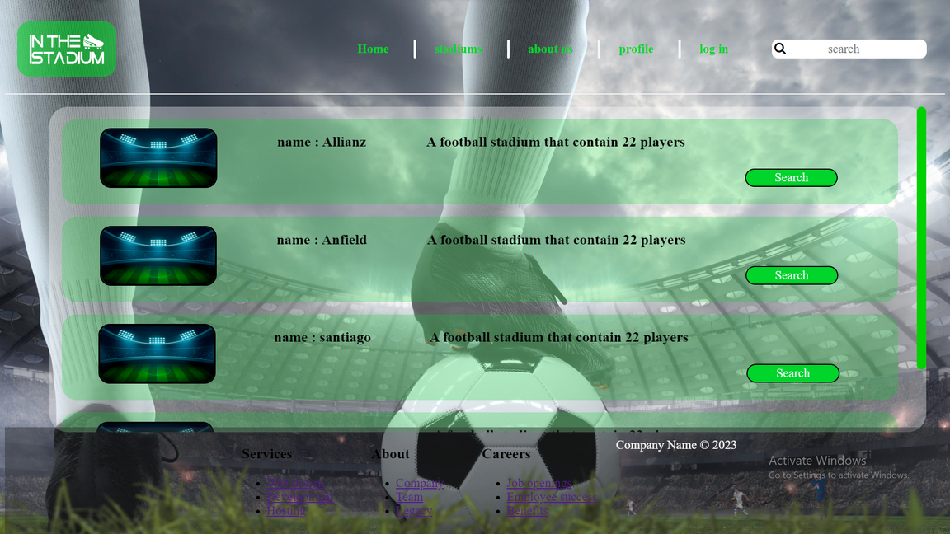
screen shots:
big stadium

Slide 12
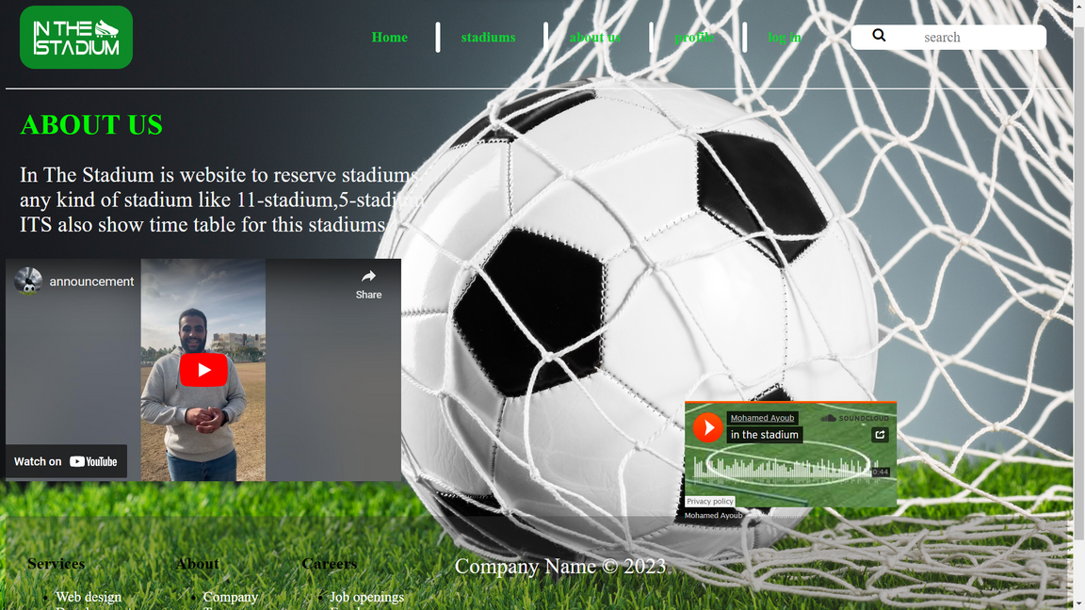
screen shots:
about us

